Slide 1
Handling Arrays in Java

Slide 2
Mr. M.R. Solanki
Sr. Lecturer, Information Technology,
manish_ratilal2002@yahoo.com
SBMP

Slide 3
Learning Outcomes
Students will be able to:
Declare and create array of primitive types
Declare and create array of primitive types

Slide 4
Array of primitive types

Slide 5
Array of primitive types
An array is a group of like-typed variables that are referred to by a common name.
Step 1: Declaration of an array (create the reference)
Syntax: type var-name[ ];
Example int a[];
Step 2: Creation of an array
Syntax: array-var = new type [size];
Example a = new int[10];

Slide 6
We can combine 2 steps as follows:
int a[] = new int[10];
# we can take size from the user :
int a[] = new int[size];
#The elements in the array allocated by new will automatically be initialized to zero (for numeric types), false (for boolean), or null (for reference types)

Slide 7
Compile time initialization
We can initialize arrays at compile time as shown below:
Syntax: type var-name[ val1,val2,val3, … , valn];
Example: int a[] = {1,2,3,4,5};
Java provides an in-built length variable for arrays to get the length of an array.
Syntax: arr.length
System.out.println(a.length);
Use:
for(i=0;i<a.length;i++)
{
System.out.println(a[i]);
}

Slide 8
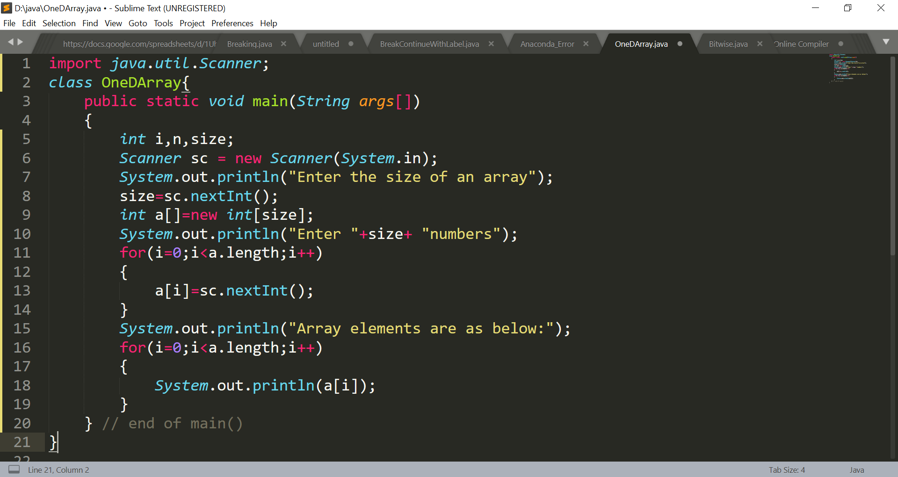
Array of primitive types

Slide 9
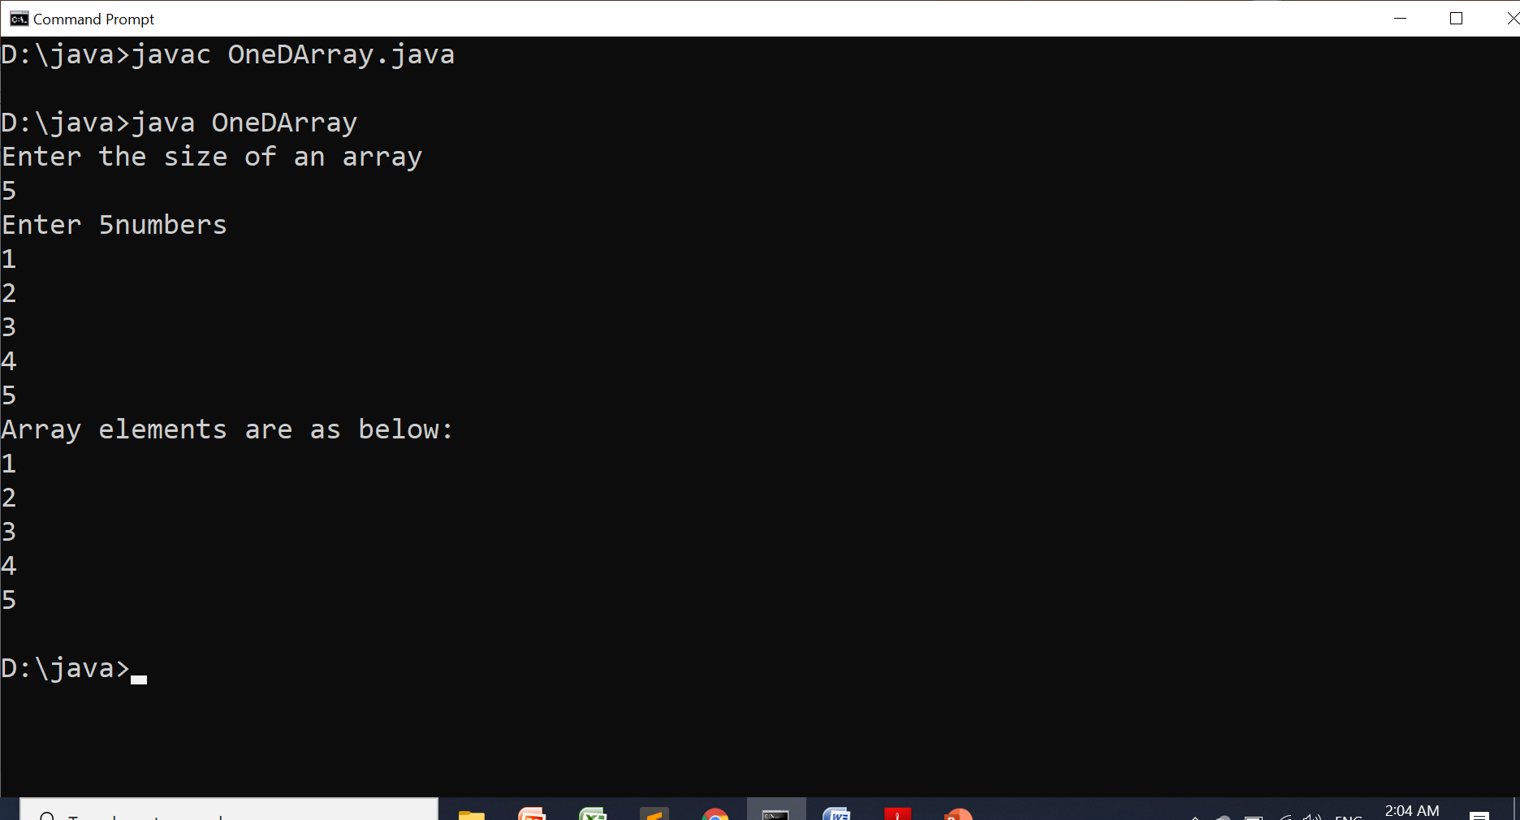
Array of primitive types

Slide 10
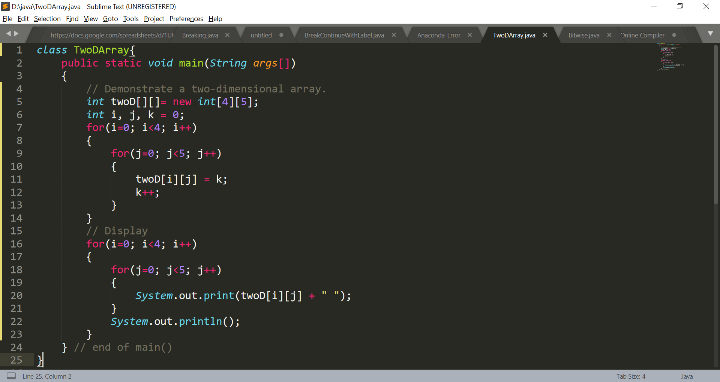
Multidimensional Arrays
Declaration of 2-D Array:int twoD[][] = new int[4][5];

Slide 11
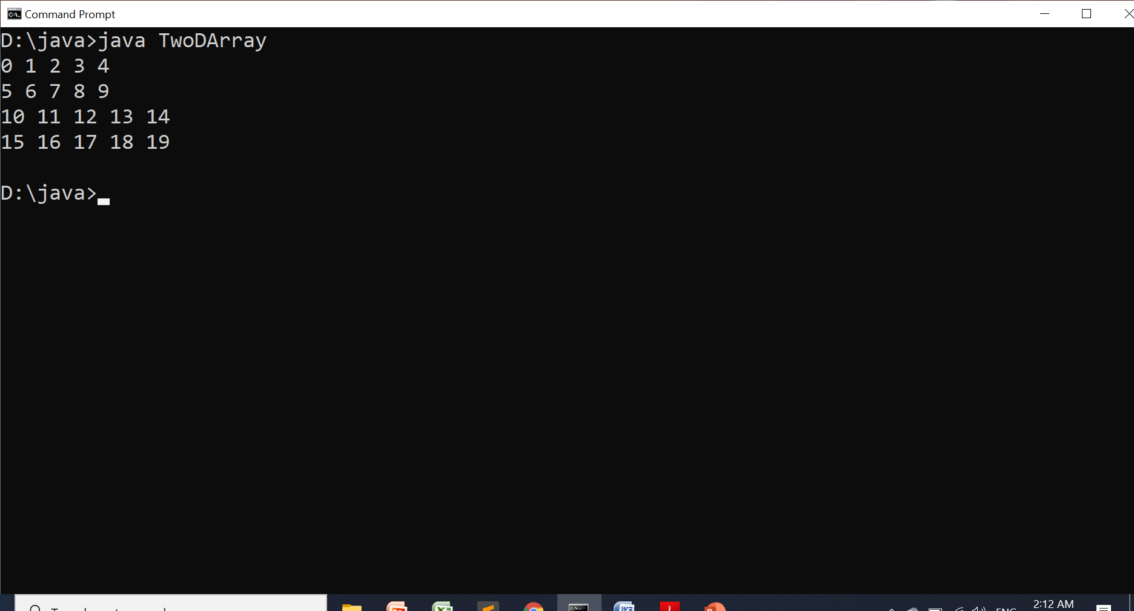
Multidimensional Arrays

Slide 12
Multidimensional Arrays
Flexible 2-D Array:
When you allocate memory for a multidimensional array, you need only specify the memory for the first (leftmost) dimension.
You can allocate the remaining dimensions separately.
int twoD[][] = new int[4][];
twoD[0] = new int[1];
twoD[1] = new int[2];
twoD[2] = new int[3];
twoD[3] = new int[4];

Slide 13
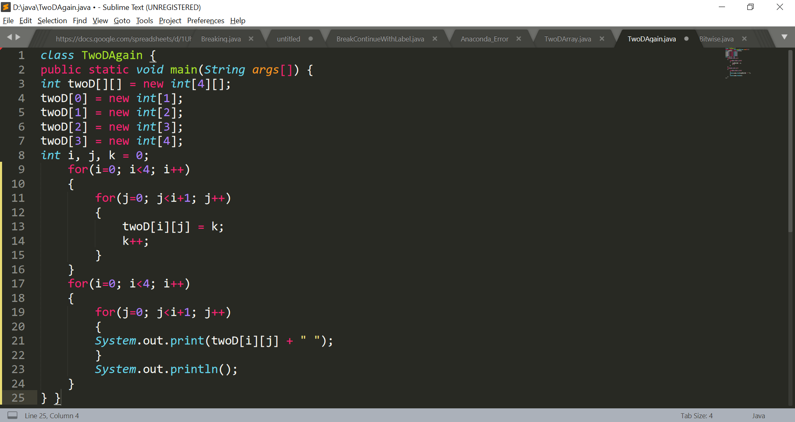
Multidimensional Arrays

Slide 14
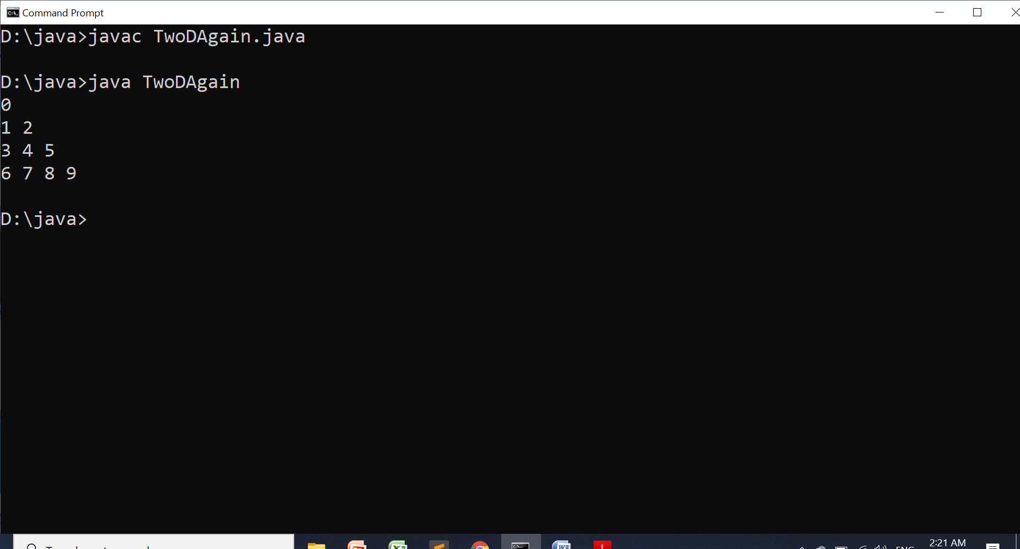
Multidimensional Arrays

Slide 15
Array of Objects

Slide 16
Creating array of objects
Step1: Declaring array of objects
Syntax: Class_Name ref[] = new Class_Name[size];
Example: Employee e[] = new Employee[10];
Note: Step 1 does not create array of objects physically, it is just declaration
Step2: Creating array of objects Physically
Syntax: ref[index] = new Class_Name();
Example: e[0] = new Employee(); // employee 0 obj. is created

Slide 17
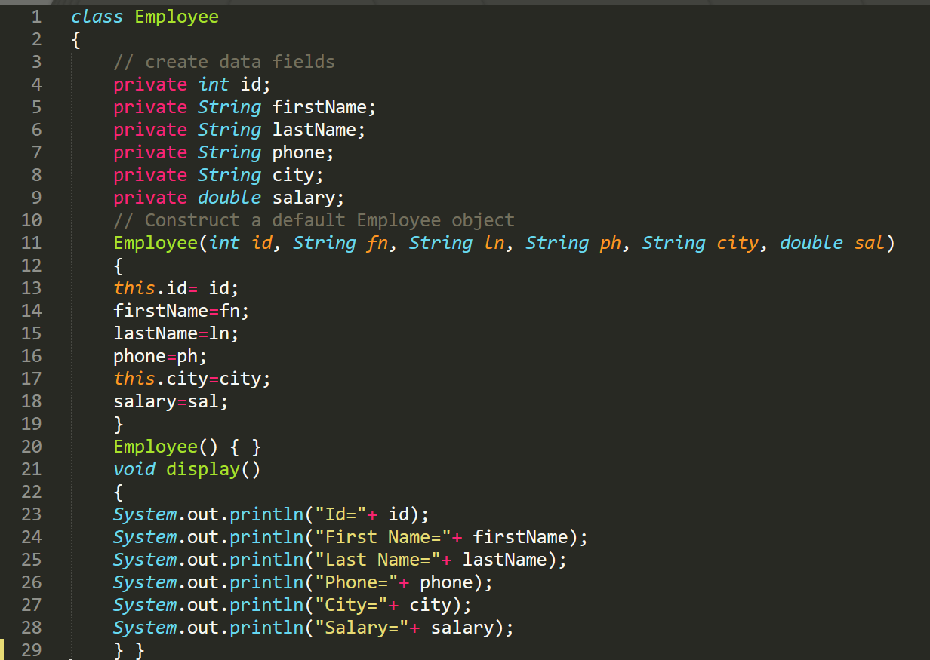
Creating array of objects

Slide 18
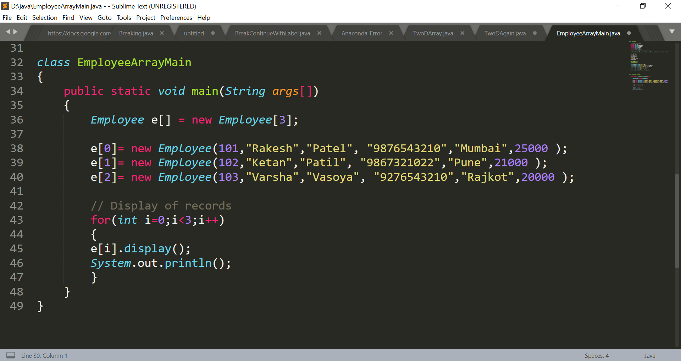
Creating array of objects

Slide 19
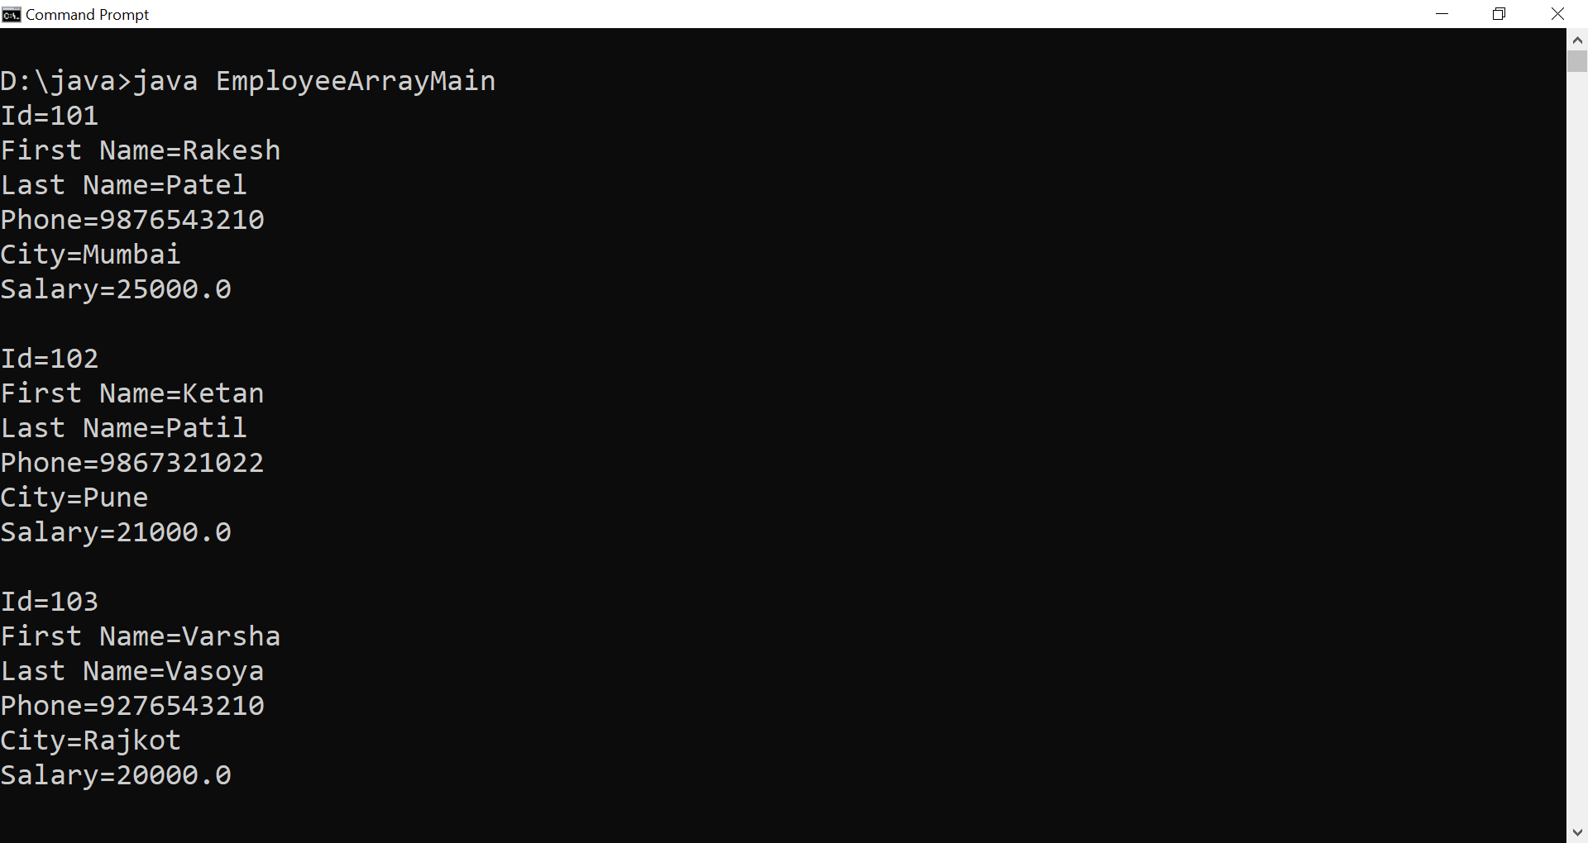
Creating array of objects

Slide 20
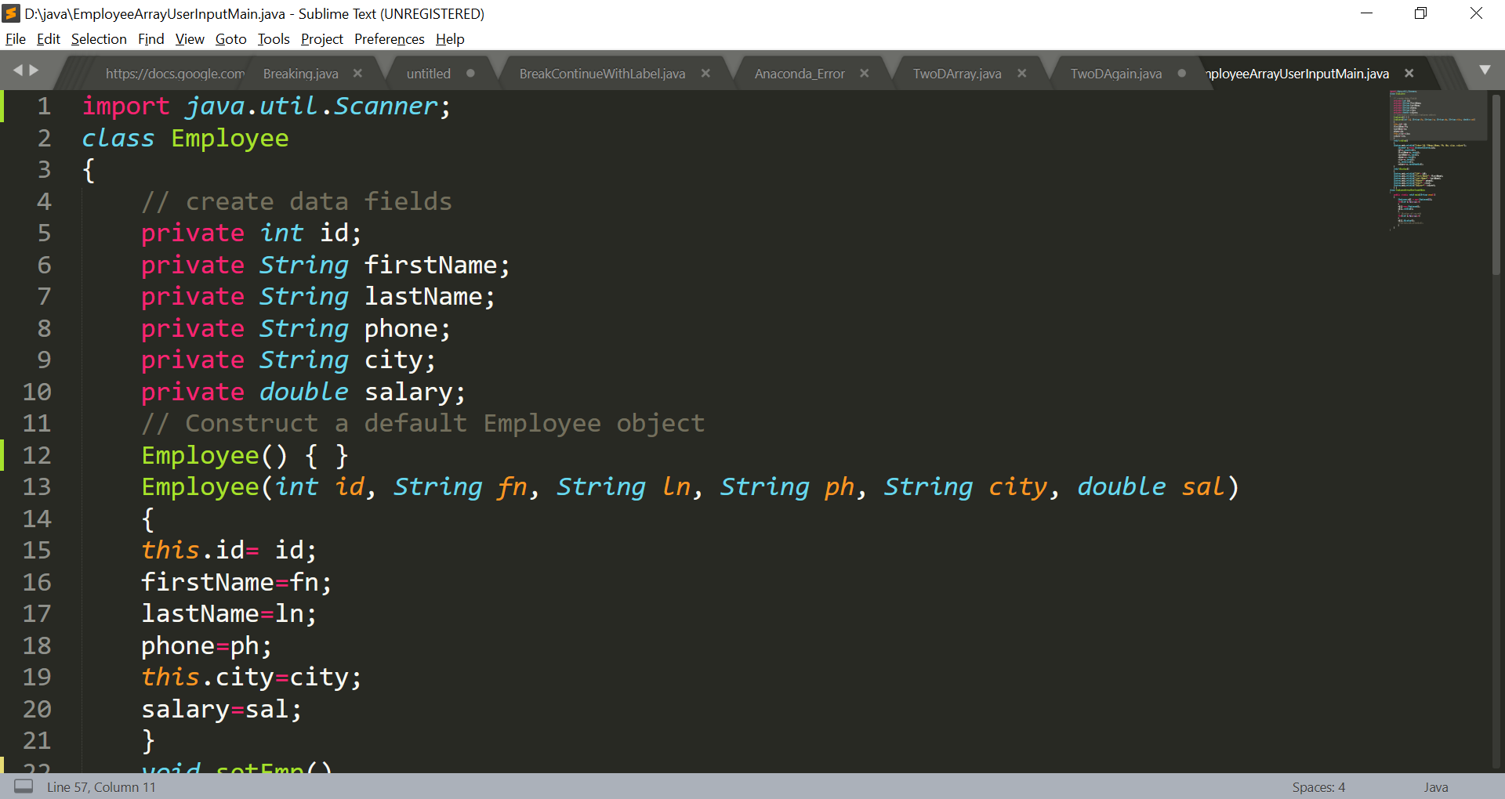
Creating array of objects taking user input

Slide 21
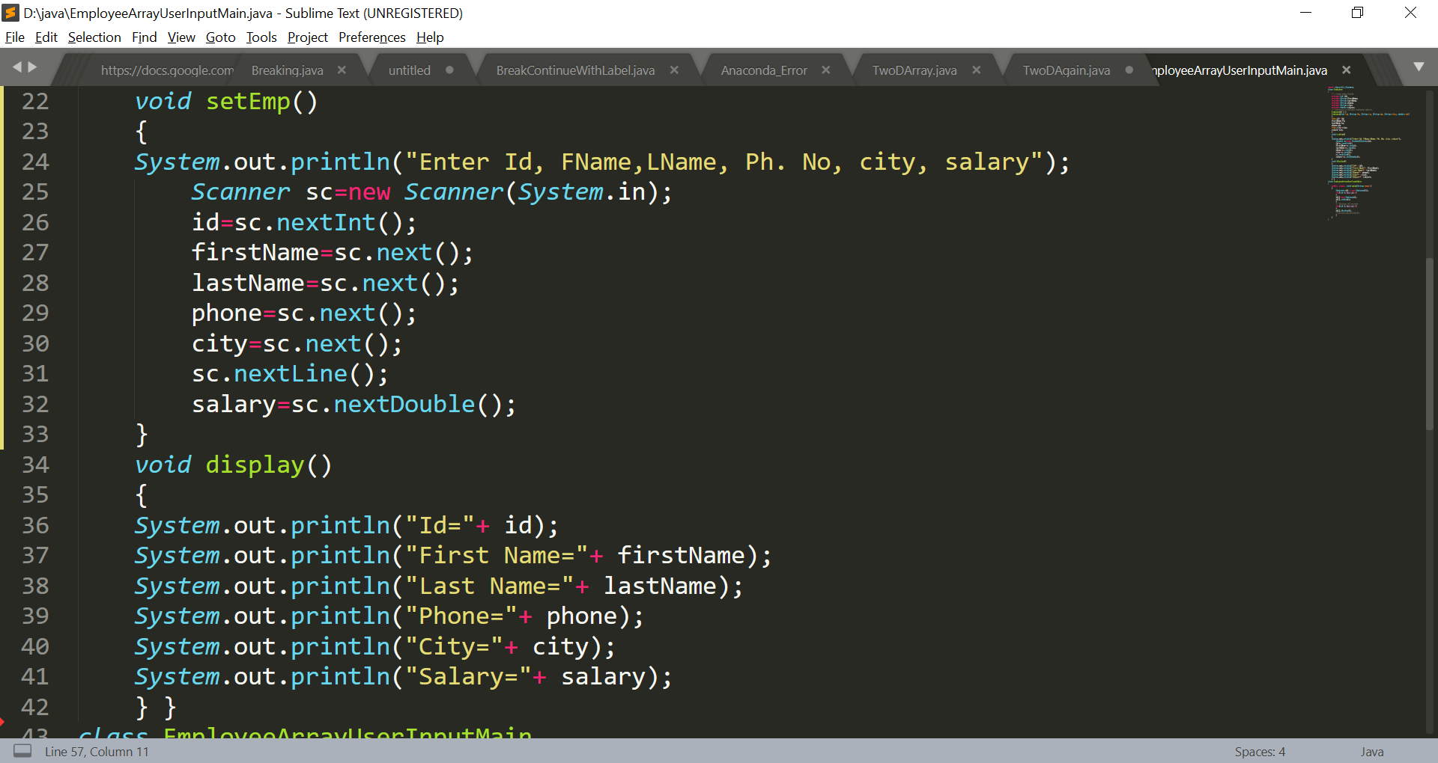
Creating array of objects taking user input

Slide 22
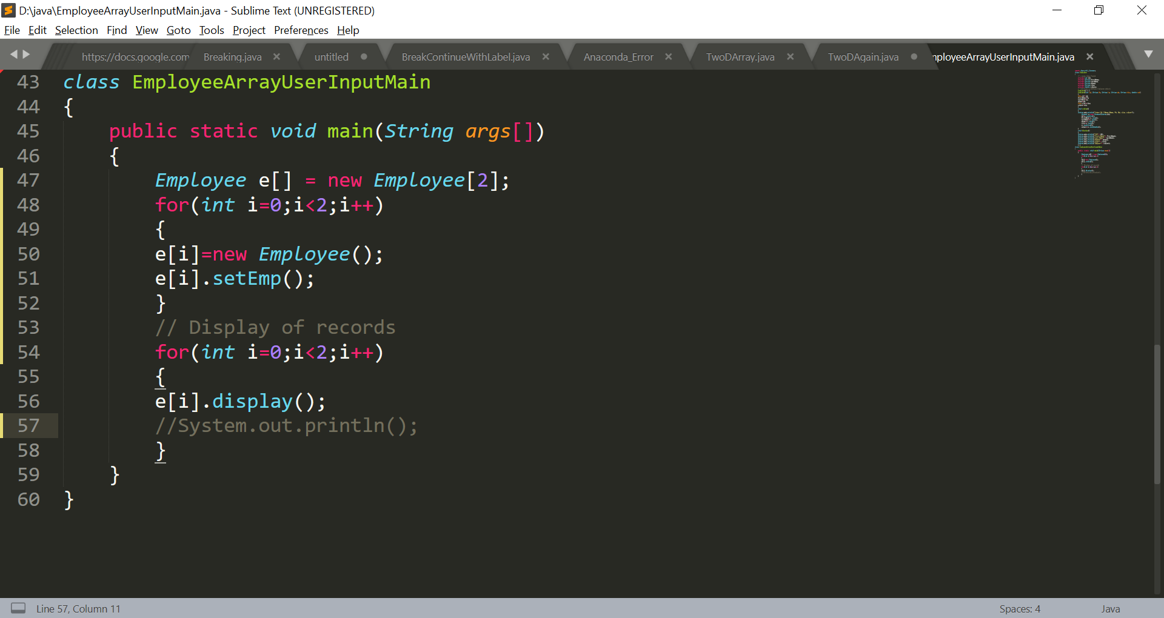
Creating array of objects taking user input

Slide 23
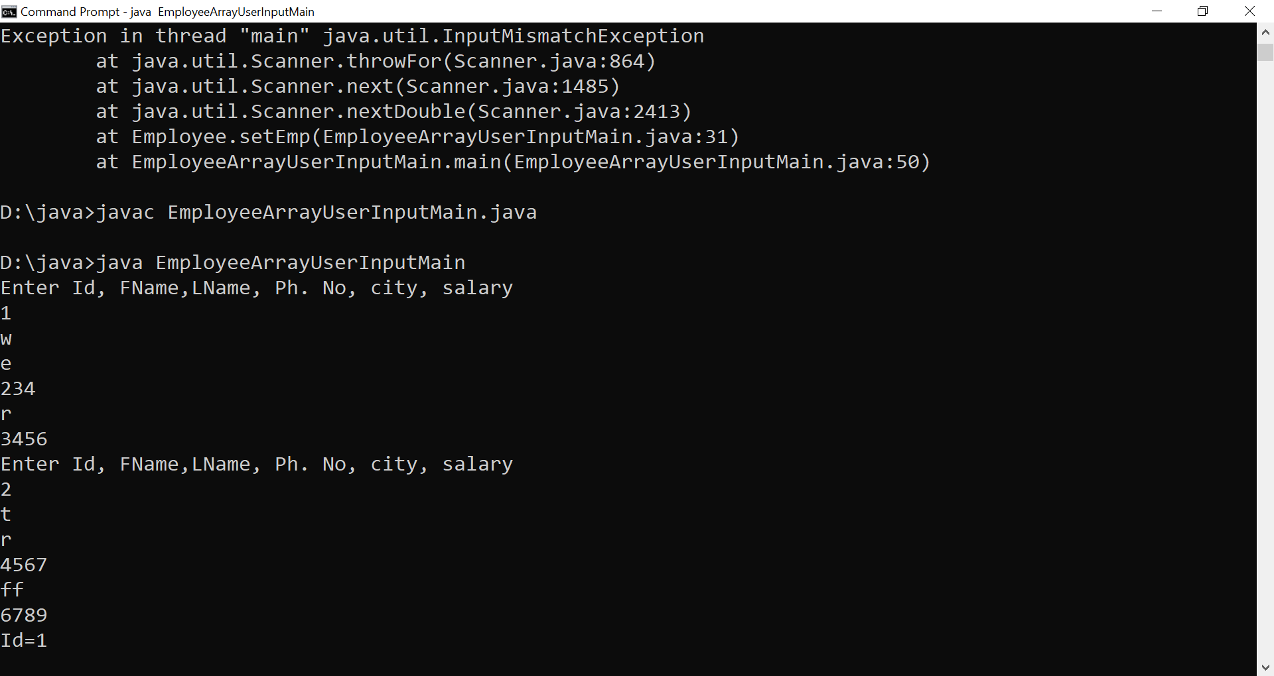
Creating array of objects taking user input

Slide 24
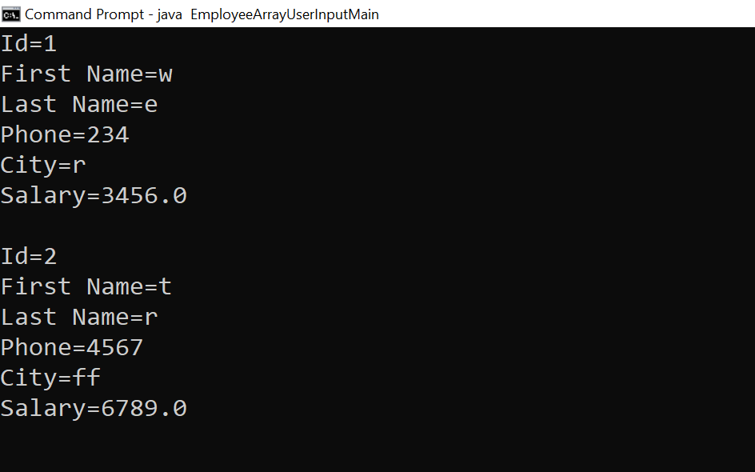
Creating array of objects taking user input

Slide 25
Thanks!
Any questions?
You can find me at:
manish_ratilal2002@yahoo.com

Slide 26
Credits
Java The Complete Reference, Ninth Edition, Herbert Schildt

